Slide 1
BCA(SCI)FY
Digital Electronics
Topic- HALF ADDER and FULL ADDER
MS CHANDKAR B A

Slide 2

HALF ADDER
An adder is a digital circuit that performs addition of numbers. Adders are classified into two types . One is Half Adder, and another one is known as Full Adder .The half adder adds two binary digits and produces two outputs as sum and carry. It consists of one XOR logic gate producing “SUM” and one AND gate producing “CARRY” as outputs.
Block Diagram of Half Adder

Slide 3
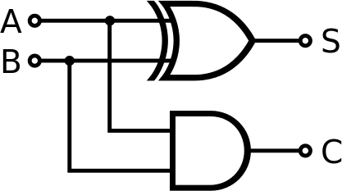
There are two inputs and two outputs in a Half Adder. Inputs are named as A and B, and the outputs are named as Sum (S) and Carry (C).
Figure (1) Half Adder Logic Circuit

Slide 4
HALF ADDER TRUTH TABLE
INPUTS |  | OUTPUTS
A | B | S(Sum) | C(Carry)
0 | 0 | 0 | 0
1 | 0 | 1 | 0
0 | 1 | 1 | 0
1 | 1 | 0 | 1

Slide 5
LIMITATION OF HALF ADDER
The major drawback of HALF ADDER circuit is that it can only add two inputs and if there is any carry it is neglected. Thus, the process is incomplete. To overcome this drawback Full Adder is designed.

Slide 6
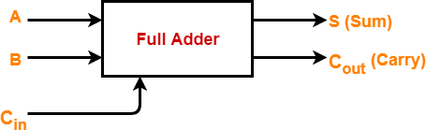
FULL ADDER
A full adder is a combinational circuit that performs an
addition operation on three binary digits. It consists of three
inputs and two outputs. The first two inputs are A and B and
the third input is an input carry designated as Cin. The
output carry is designated as Cout and the normal output is designated as S.
Block Diagram of Full Adder

Slide 7
A full adder circuit can be implemented using two half adders and one OR gate. The first half adder will be used to add A and B to produce a partial Sum and the second half adder
can be used to add Cin to the Sum produced by the first half adder to get the final S output. If any of the half adder produces a carry, there will be an output carry. So, Cout will be an OR function of the half adder Carry outputs.

Slide 8
Since a full adder has the previous carry as an input , it can be used to add multi-digit binary numbers. The multi-digit binary numbers are added by a cascading connection of multiple full adders. The number of full adders in cascade connection is equal to the number of digits to be added.

Slide 9
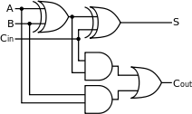
Figure(2) Full Adder Logic Circuit

Slide 10
FULL ADDER TRUTH TABLE
INPUTS |  |  | OUTPUTS
A | B | Cin | S(sum) | Cout (carry)
0 | 0 | 0 | 0 | 0
0 | 0 | 1 | 1 | 0
0 | 1 | 0 | 1 | 0
0 | 1 | 1 | 0 | 1
1 | 0 | 0 | 1 | 0
1 | 0 | 1 | 0 | 1
1 | 1 | 0 | 0 | 1
1 | 1 | 1 | 1 | 1

Slide 11
APPLICATIONS OF HALF ADDER AND FULL ADDER
There are many applications of Half Adder and Full Adder. These circuits are used basically in building of any digital electronics device . Half adder and Full adder can be used to make other arithmetical and logical circuits like ALU . These circuits are mainly designed for the addition of binary number, but they can be used in various other applications like binary code decimal, address decoding, table index calculation, etc.

Slide 12
THANKS

